Slide 1


Assembly Utilities & Energy and Insurance Committees
Joint Hearing on Subrogation
Michael Wara
October 29, 2026

Slide 2
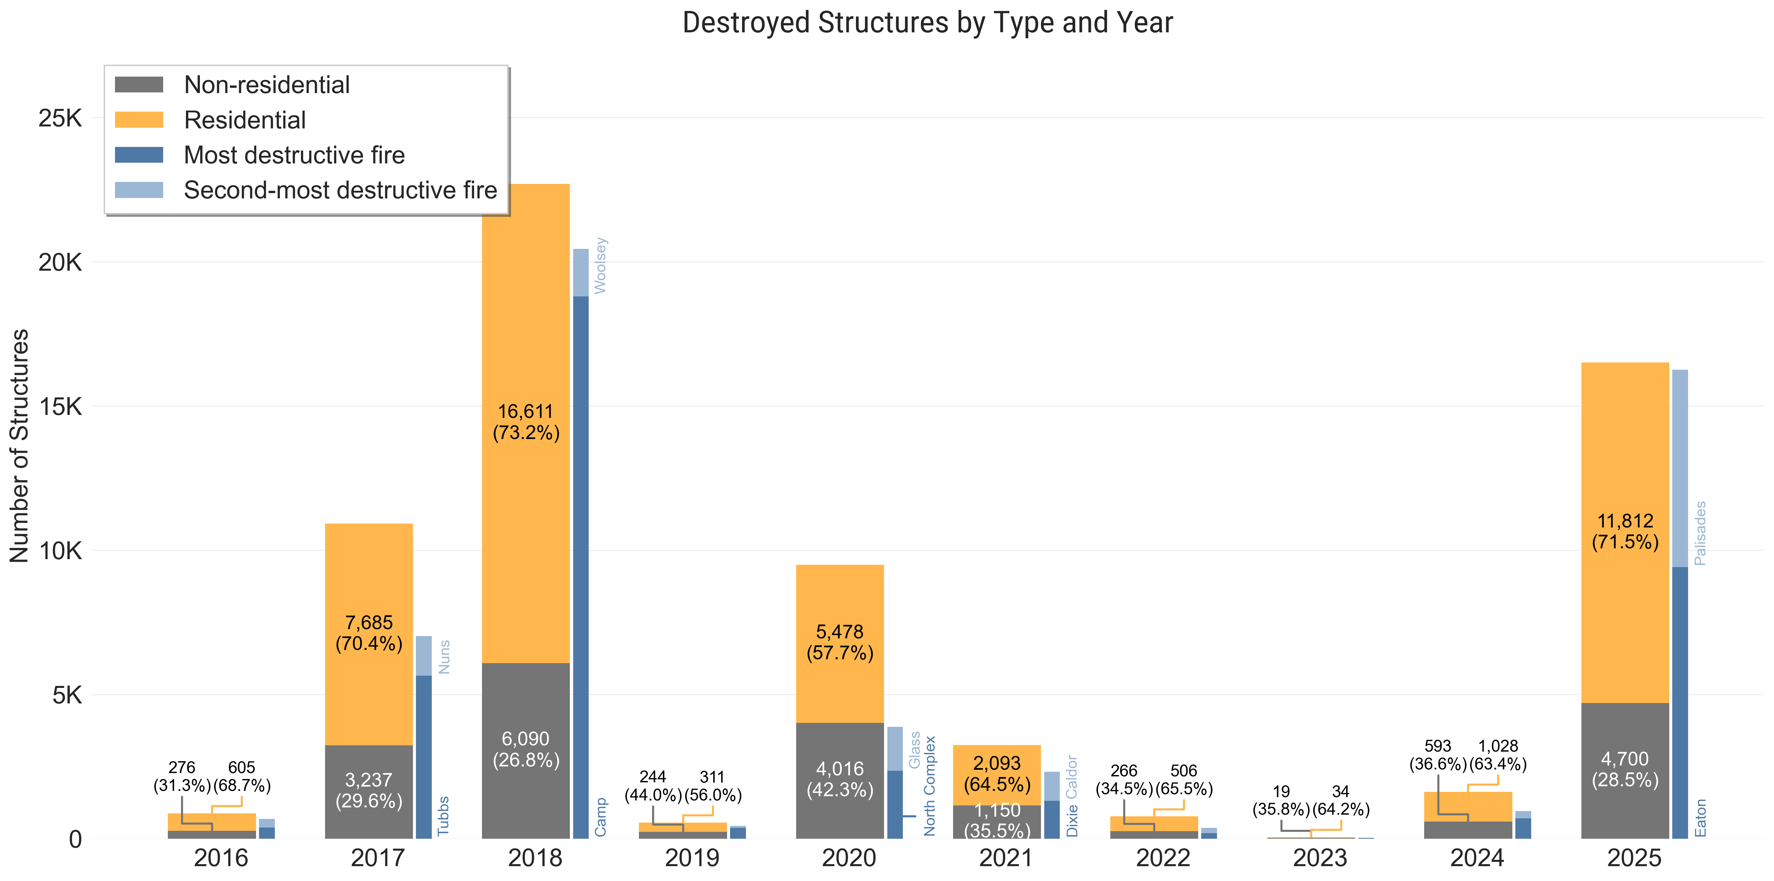
Wildfire structure loss is unprecedented

Slide 3
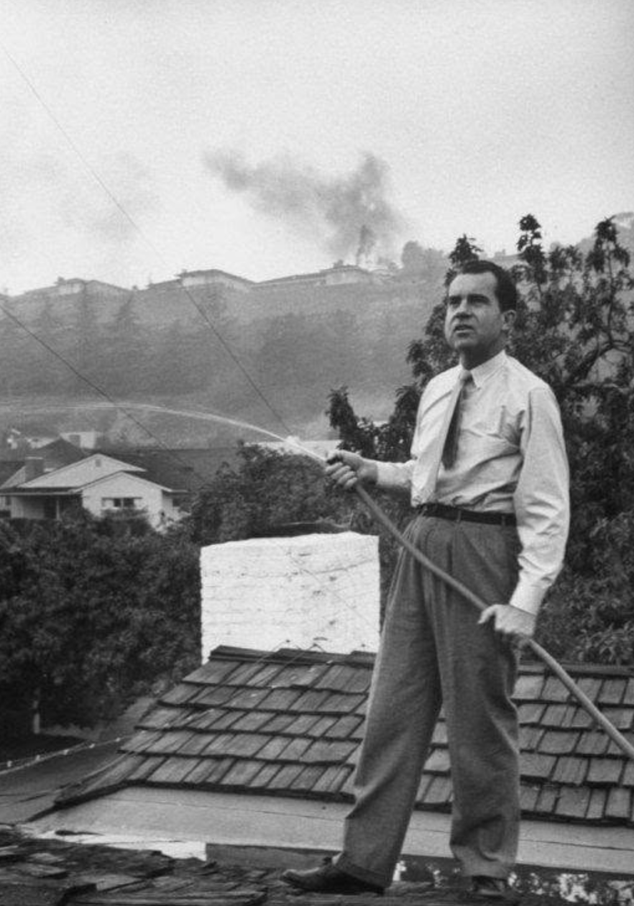
Wildfire structure loss is unprecedented
Richard Nixon fights the Bel Aire Fire, 1961, 484 structures lost.

Slide 4
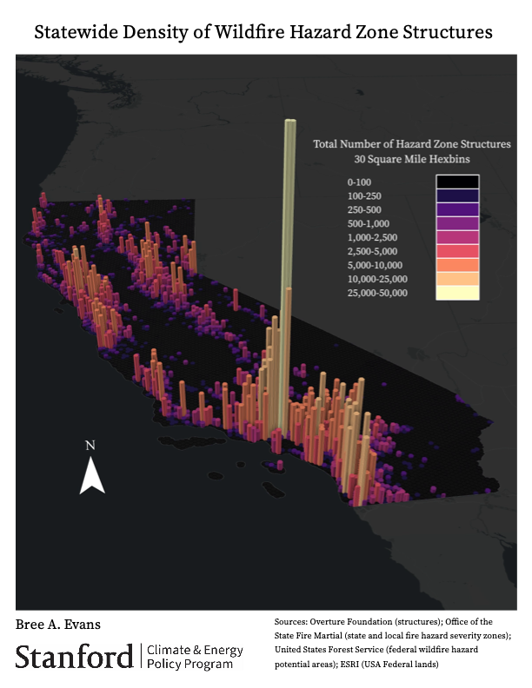
Subrogation against whom?
Structures Counts in Wildfire Hazard Severity Zones
PG&E Corporation – 1,096,463 (23%)
Edison International – 992,841 (22%)
SDG&E – 441,136 (40%)
LADWP – 246,183 (23%)
See, Evans et al., 2026, https://wuistructurallookbook.stanford.edu

Slide 5
How big is the impact of subrogation on utility customers? It depends
                Who pays for wildfires (does Legislature make changes?)
                Legal certainty regarding inverse condemnation doctrine
                Solvency of payor/access to and cost of borrowing
                Priority in bankruptcy of unsecured creditor claims
                All of these drive settlement value for utility caused fires

Slide 6
What will likely happen for the Eaton Fire?
Typical subrogation fraction of total liability has been ~40%
Typical settlements have been 55% of claim
Eaton Fire settlements may be higher – perhaps 70%
    These claims will be paid out of the California Wildfire Fund
    Little to no impact on customers beyond Wildfire Fund costs associated with subrogation ($0.89 to $1.30 per month to 2035)

Slide 7
What if there are more utility caused fires?
Subsequent IOU Fire, $22B loss in 2027
Wildfire Fund Continuation account exhausted ($12B NPV)
Assume remaining $10B liability is 40% subrogation/60% other claims (55% settlement value)
Assume prudence - ratepayers are accountable for liability
Cost per customer depends on customer count and load
In addition to Wildfire Fund securitization charge to 2045
SCE customer impact of about $4.50/month for 30y
PG&E customer impact of about $4.15/month for 30y
SDG&E customer impact of about $14/month for 30y

Slide 8
What if there are more utility caused fires?
Subsequent POU Fire, $22B loss in 2027
California Wildfire Fund not available to pay claims
Assume remaining $22B liability is 40% subrogation/60% other claims (55% subrogation settlement value)
Prudence is irrelevant to POU liability
LADWP customer impact of about $33/month for 30y

Slide 9
How much do utility customers save if subrogation rights are modified?
Question of what is status quo? Is it 55% or 70% settlement value?
If subrogation capped at 50% and settlement value is 55%, 10% cost savings for utility customers on prior estimates.
If subrogation capped at 50% and settlement value is 70%, 29% cost savings for utility customers on prior estimates.
If subrogation eliminated, customer savings from $4.15 to $33 per month for 30y on a $22B fire and enhanced durability of Wildfire Fund Continuation Account.

Slide 10
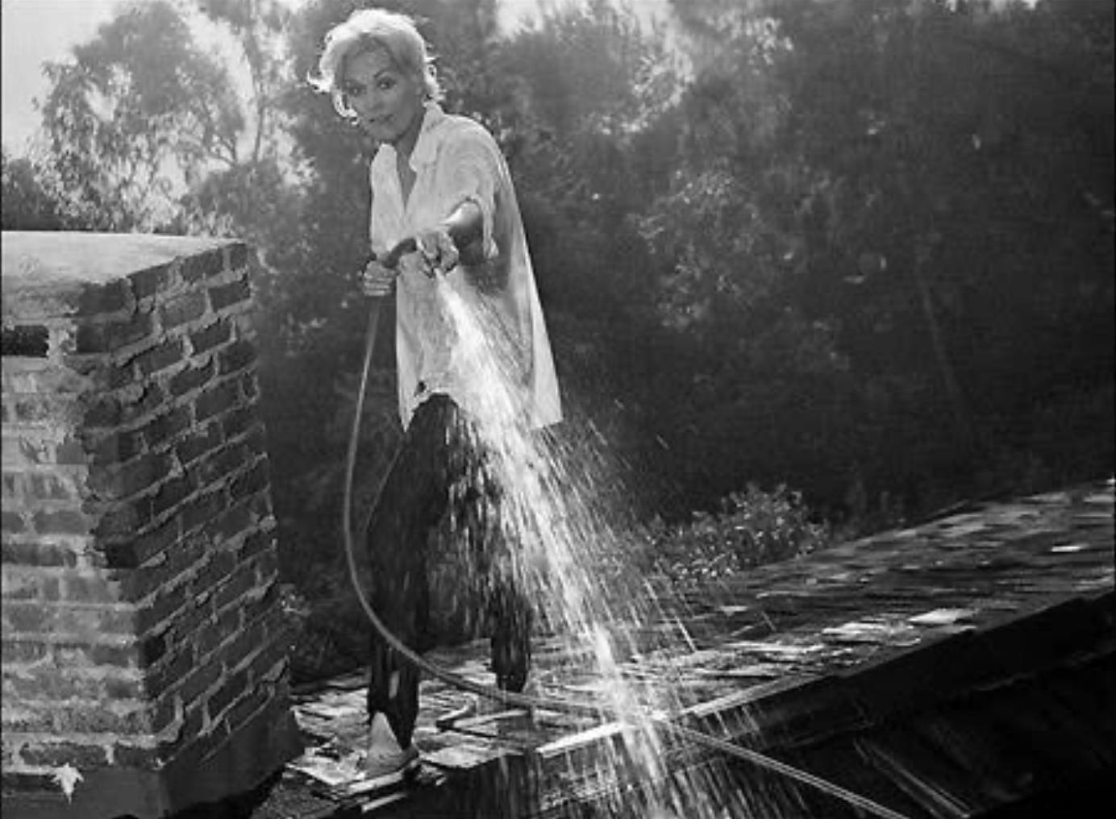
Conclusions
Subrogation costs are an important contributor to overall utility wildfire liability.
Magnitude depends on factors that have varied through time and will change depending on if there are changes to wildfire liability structure.
Customer bill impacts of future large loss events depend on multiple factors.
Kim Novak fights the Bel Aire Fire, 1961

Slide 11
Thank you
https://cepp.stanford.edu
2026 Year in California Wildfire released on November 5th!

